Slide 1
Eli Chandler Sprint 000
Mar 29 – Apr 12
Work hard rating 5/5

Slide 2
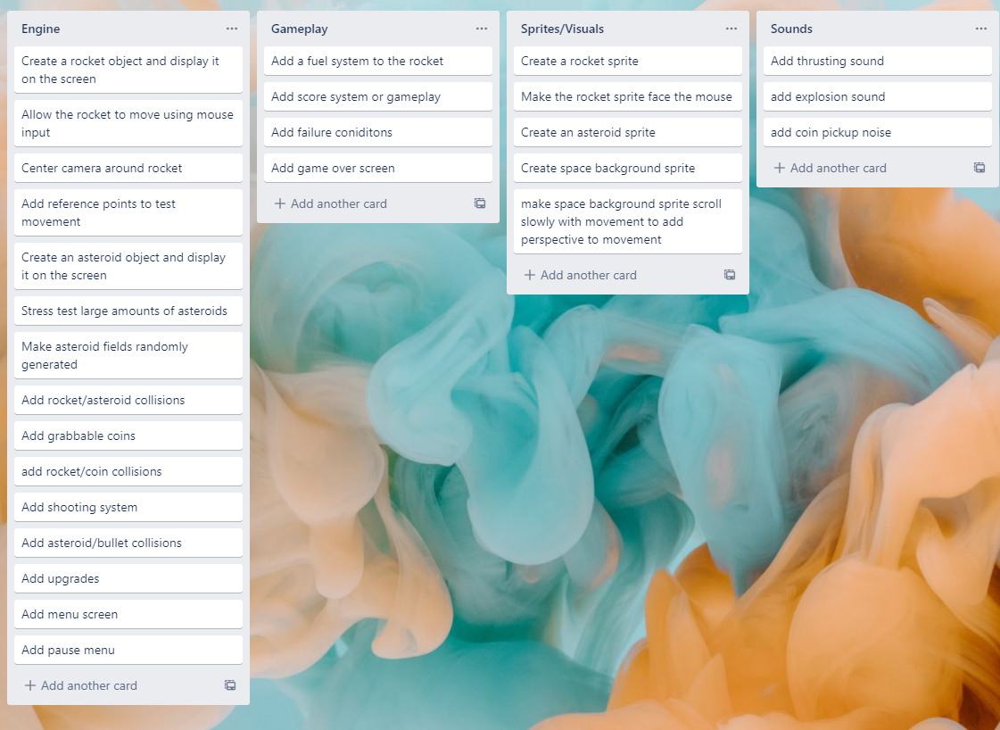
KANBAN Board at the start of the sprint

Slide 3
Sprint reflection and summary
I think I accomplished a lot in this sprint and made a good base game to expand features onto. It was important to get the game properly running and optimized at the start to avoid running into issues later on that would have cost me more time because the program would have been more complicated.
I added a basic movement system by getting the mouse position and left click inputs, than using trigonometry to find the proper amount of thrust to apply in each direction i.e. if the mouse is straight above the rocket it should apply all thrust upwards but if its at a 45 degree angle it should apply the thrust 50/50 sideways and upwards
For my collision system I had to undergo a lot of testing to make collisions not laggy, the issue ended up being that I was using spatial hashing on moving sprites which causes performance issues in the arcade library, I found out that in general large numbers of moving sprites cause issues in the arcade library and pygame is actually better for this usecase, however I think with further optimization it won’t be an issue.

Slide 4
Major changes and achievements
Created a sprite class for the rocket.
Got a movement system working using mouse input.
Added asteroids that can be spawned into asteroid fields.
Added infinite asteroid field spawning system (chunks)
Added random variance to asteroids for better visuals.
Added collision detection between asteroids/rocket
Added home-base that rocket respawns at
Added grabbable coins
Added coin spawning system (chunks)
One major achievement is me overcoming the issue of my asteroid system being incredibly laggy, the issue was me originally not using spritelists and instead looping through every single asteroid which was slow. Than I used a spritelist but didn’t disable spatial hashing to begin with which is an issue with a large number of moving sprites in the arcade library, after scraping through the documentation I found that spatial hashing was the issue so I disabled spatial hashing for my asteroid spritelist. I didn’t disable for my coin spritelist because the coin sprites don’t move so I it isn’t an issue for them.

Slide 5
Brief description of your testing
Movement:
Movement was the first mechanic I implemented so I had to keep things simple, I used an arcade square object to represent the rocket and an arcade ellipse object to represent a reference point. I added a system that found the angle of the mouse relative to the rocket and than added a thrusting system to the rocket. To test it I used my reference point and flew around it to see if the movement lined up with the users inputs.
Asteroids:
I started off by just having the asteroids as an arcade circle object that would be spawned on draw, but trying it with around 50 asteroids I realized that this was very performance intensive and not going to work for my use case- I wanted the screen to be filled with around 100 floating asteroids.
So I implemented a sprite list and chunk loading system, where there was a 3x3 area centered around the rocket and in each segment 100 asteroids were spawned, if a segment goes out of the 3x3 area it is despawned. This system is not perfect for performance but it is better than the circles. The game runs at around 40 FPS which is not ideal, I need to work on this system in my next sprint.
As for collisions I found they were extremely laggy so I did some research and found that arcade spatial hashing doesn’t play well with a large number of moving sprites, so I disabled spatial hashing and this was fixed.
Coins:
I started off by just generating coins in fixed places on the screen to make sure it was working properly, originally they were too big so I had to adjust the scaling
I learned from my mistakes with the asteroids and made a sprite list for the coins, but with this sprite list I left spatial hashing on as the coin sprites would not be moving so the slowdown that happened with Asteroids would not happen with coins
I used the same chunk system as the asteroids but with a lower spawn frequency

Slide 6
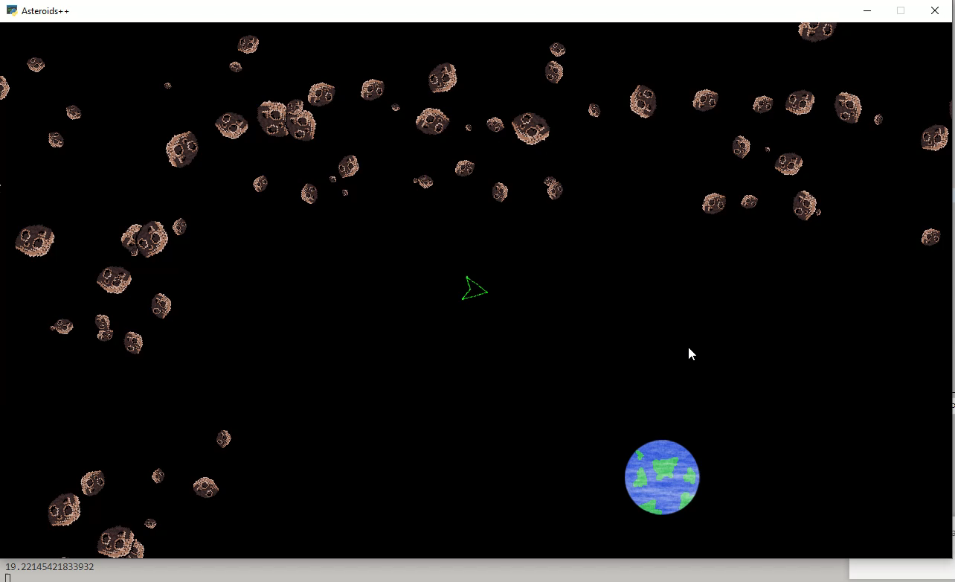
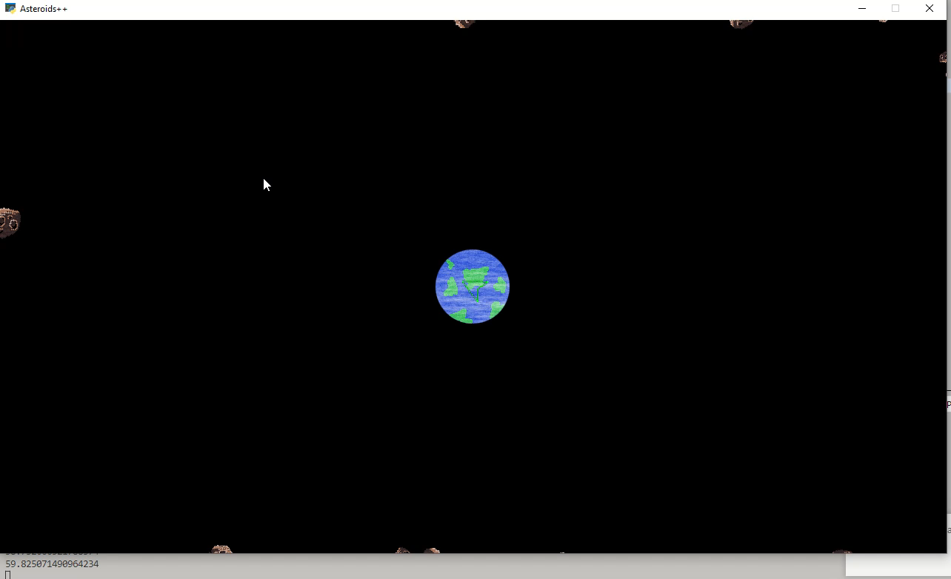
testing
Spatial hashing off:
Game averages around 60FPS (But FPS Drops on loading in new asteroid/coin chunks
Spatial hashing on:
Game averages around 20FPS

Slide 7
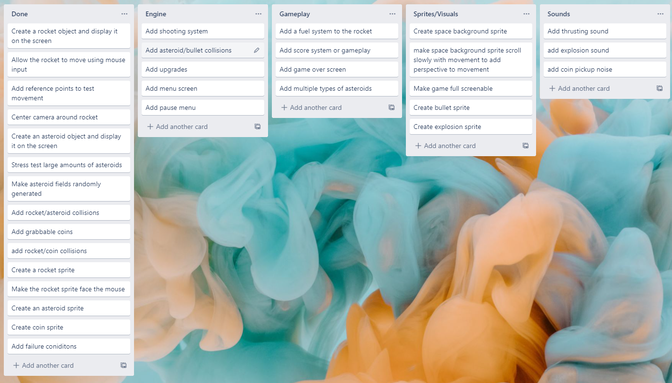
KANBAN Board at end of the sprint

Slide 8
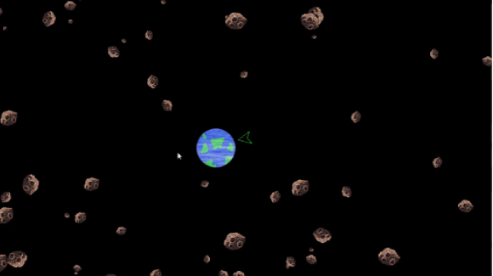
Screenshot of the game at the end of the sprint

Slide 9
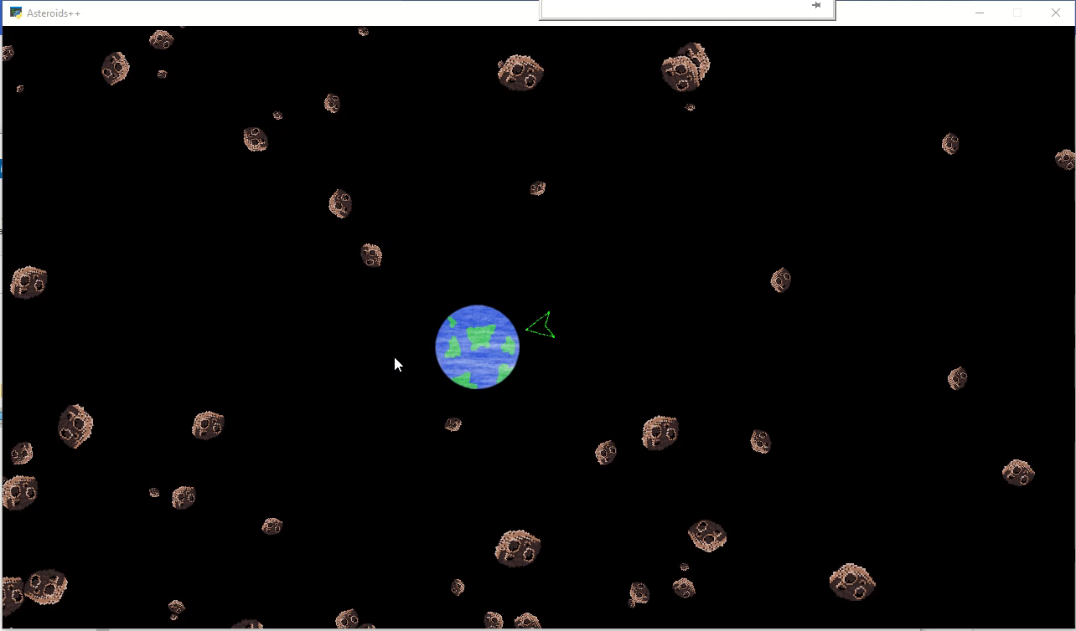
Video of the game at the end of the sprint

Slide 10
Notes for next time, future improvements
In my next version I would like to polish the code a bit as I am currently using 2 separate objects for my rocket when I could just be using one, I would also like to take a further look at the asteroid spawning system to see if I can find a more efficient and uniform method of spawning them, I am thinking of having a system where there is a radius around the rocket, and if asteroids go outside that radius they despawn and a new asteroid is randomly spawned somewhere.

